Slide 1
The Battle of Neighborhoods
Coursera Capstone Project
Elizabeth W.

Slide 2
Introduction
Problem: I need to decide where to live for a job near Irvine, California. I don’t know a lot about the area, so would like to use the data to inform my decision. I like performing arts and coffee shops, so would like to live near these types of places.
The places I will compare are:
Long Beach
Irvine
Costa Mesa
Anaheim
Lake Forest
Notes:
Introduction where you discuss the business problem and who would be interested in this project.

Slide 3
Data
Geocoder – Nominatum
I will use this to find the coordinates of each city I will compare
Foursquare API
I will use this to find businesses near each neighborhood, and calculate the concentration of relevant venue types to rank the neighborhoods
Notes:
Data where you describe the data that will be used to solve the problem and the source of the data.

Slide 4
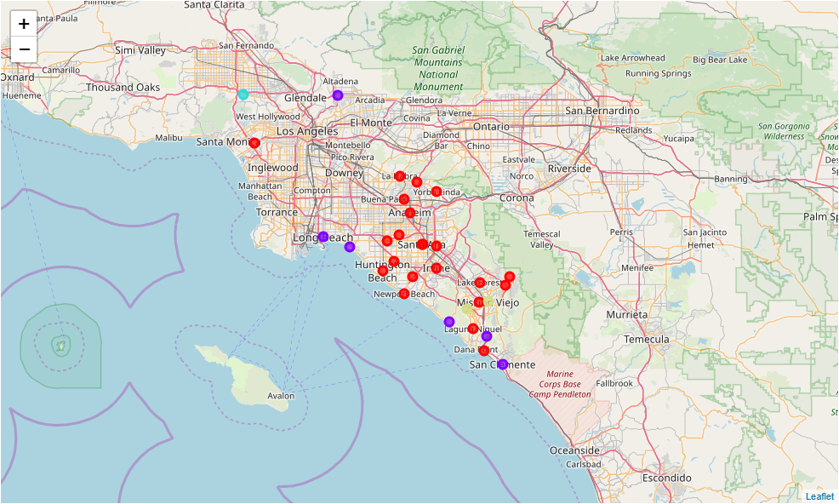
Methodology
Clustering based on types of venues leads to 4 clusters.
Added three reference cities that help us evaluate the clusters: Palms, Pasadena, and Sherman Oaks
Notes:
Methodology section which represents the main component of the report where you discuss and describe any exploratory data analysis that you did, any inferential statistical testing that you performed, and what machine learnings were used and why.

Slide 5
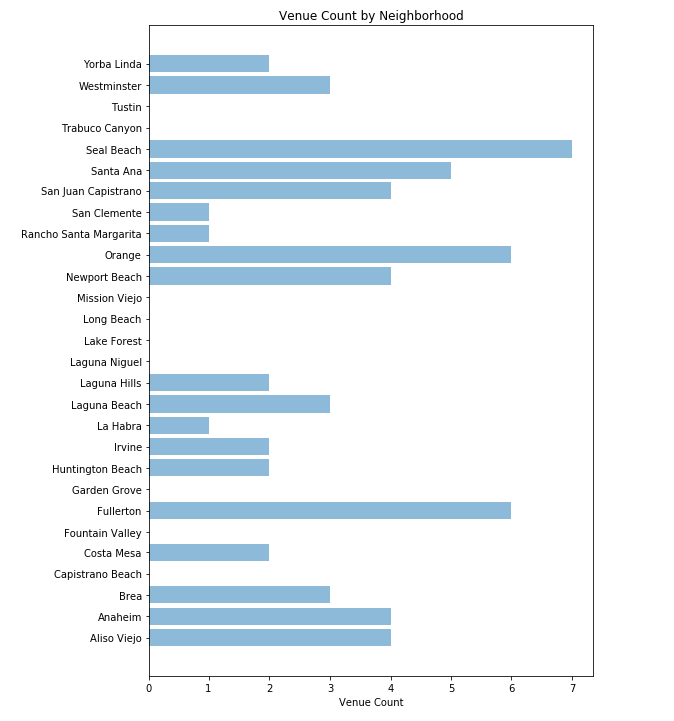
Methodology
To rank within each cluster, counted the types of venues we like to visit
Coffee Shops
Cafés
Theaters
Concert Halls
Parks
Notes:
Methodology section which represents the main component of the report where you discuss and describe any exploratory data analysis that you did, any inferential statistical testing that you performed, and what machine learnings were used and why.

Slide 6
Results
We now have a dataframe with each city, a cluster category, and a number of attractive venues that we would likely visit
Cluster 0: Like Palms
Cluster 1: Like Pasadena
Fullerton (6)
Orange (6)
Santa Ana (5)
Newport Beach (4)
Anaheim (4)
Long Beach (7)
Seal Beach (7)
San Juan Capistrano (4)
Laguna Beach (3)
San Clemente (1)
Notes:
Results section where you discuss the results.

Slide 7
Discussion
Many cities in Orange County seem similar to each other based on this cluster analysis, devaluing our clustering as a decision mechanism
Using counts of venues makes sense, because we looked at a fixed radius for each city. Count of venues is a great way to measure our interest and will serve as a ranking tool
We can’t guarantee we will find housing in one specific city, so we will use the list of rankings to inform our discussion with a real estate agent.
Notes:
Discussion section where you discuss any observations you noted and any recommendations you can make based on the results.

Slide 8
Conclusion
After completing the clustering and ranking exercises, we are now prepared to move to a new city for this job, and also have a list of popular venues to visit. This increased my confidence in moving, and now instead of anxious, I am excited to see a new part of California.
Once we have settled in, next analysis projects could include using Foursquare API again to rank local restaurants in the order that we should try them.
Notes:
Conclusion section where you conclude the report.

